Slide 1
Collections

Slide 2
Collections
Implementation of fundamental collections (dynamic arrays, linked lists, trees, and hash tables) are highly efficient.
Several standard implementations (such as LinkedList, HashSet, and TreeSet) of these interfaces are provided that you may use as-is.
You may also implement your own collection.
Algorithms operate on collections and are defined as static methods within the Collections class.
An iterator offers a general-purpose, standardized way of accessing the elements within a collection,

Slide 3
The Collection Interfaces
Collection - Enables you to work with groups of objects; it is at the top of the collections hierarchy.
Deque - Extends Queue to handle a double-ended queue
List - Extends Collection to handle sequences (lists of objects).
NavigableSet - Extends SortedSet to handle retrieval of elements based on closest-match searches.
Queue - Extends Collection to handle special types of lists in which elements are removed only from the head.
Set - Extends Collection to handle sets, which must contain unique elements.
SortedSet - Extends Set to handle sorted sets.
In addition to the collection interfaces, collections also use the Comparator, RandomAccess, Iterator, and ListIterator interfaces

Slide 4
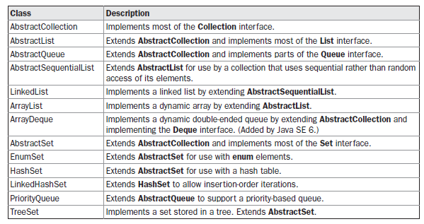
Collection classes

Slide 5
ArrayList
class ArrayListDemo {
public static void main(String args[]) {
ArrayList<String> al = new ArrayList<String>();
System.out.println("Initial size of al: " +
al.size());
al.add("C");
al.add("A");
al.add("E");
al.add("B");
al.add("D");
al.add("F");
al.add(1, "A2");
System.out.println("Size of al after additions: " +
al.size());
System.out.println("Contents of al: " + al);
al.remove("F");
al.remove(2);
System.out.println("Size of al after deletions: " +
al.size());
System.out.println("Contents of al: " + al);
}
}
The output from this program is shown here:
Initial size of al: 0
Size of al after additions: 7
Contents of al: [C, A2, A, E, B, D, F]
Size of al after deletions: 5
Contents of al: [C, A2, E, B, D]

Slide 6
Linked List
class LinkedListDemo {
public static void main(String args[]) {
// Create a linked list.
LinkedList<String> ll = new LinkedList<String>();
// Add elements to the linked list.
ll.add("F");
ll.add("B");
ll.add("D");
ll.add("E");
ll.add("C");
ll.addLast("Z");
ll.addFirst("A");
ll.add(1, "A2");
System.out.println("Original contents of ll: " + ll);
ll.remove("F");
ll.remove(2);
System.out.println("Contents of ll after deletion: "+ ll);
// Remove first and last elements.
ll.removeFirst();
ll.removeLast();
System.out.println("ll after deleting first and last: "
+ ll);
// Get and set a value.
String val = ll.get(2);
ll.set(2, val + " Changed");
System.out.println("ll after change: " + ll);
}
}
The output from this program is shown here:
Original contents of ll: [A, A2, F, B, D, E, C, Z]
Contents of ll after deletion: [A, A2, D, E, C, Z]
ll after deleting first and last: [A2, D, E, C]
ll after change: [A2, D, E Changed, C]

Slide 7
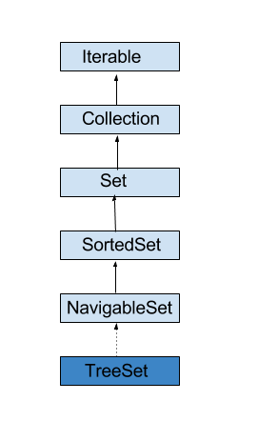
Treeset

Slide 8
Treeset
Java TreeSet class implements the Set interface that uses a tree for storage
The objects of the TreeSet class are stored in ascending order.
Java TreeSet class access and retrieval times are quiet fast.
Java TreeSet class doesn't allow null element.
Java TreeSet class is non synchronized.
Java TreeSet class maintains ascending order.

Slide 9
Treeset
class TreeSetDemo {
public static void main(String args[]) {
TreeSet<String> ts = new TreeSet<String>();
ts.add("C"); ts.add("A"); ts.add("B"); ts.add("E"); ts.add("F"); ts.add("D");
System.out.println(ts);
System.out.println("First element : " + ts.first());
System.out.println("Last element : " + ts.last());
String n="D";
System.out.println("Element just greater than " + n + " : " + ts.higher(n));
System.out.println("Element just lower than " + n + " : " + ts.lower(n));
System.out.println("Head Set: "+ts.headSet(n));
System.out.println("Head Set: "+ts.tailSet(n));
}
}
[A, B, C, D, E, F] First element : A Last element : F
Element just greater than D : E
Element just lower than D : C
Head Set: [A, B, C] Tail Set: [D, E, F]

Slide 10
TreeSet with Iterator
import java.util.*;
class TreeSet2{
public static void main(String args[]){
TreeSet<String> set=new TreeSet<String>();
set.add(“A");
set.add(“C");
set.add(“B");
System.out.println("Traversing element through Iterator in descending order");
Iterator i=set.descendingIterator();
while(i.hasNext())
{
System.out.println(i.next());
}
}
}

Slide 11
Treeset for user defined objects
The elements in TreeSet must be of a Comparable type.
String and Wrapper classes are Comparable by default.
To add user-defined objects in TreeSet, you need to implement the Comparable interface.
Refer TreesetComparable.pdf

Slide 12
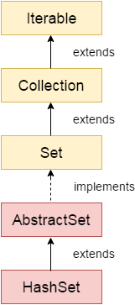
Hashset
HashSet extends AbstractSet and implements the Set interface. It creates a collection that uses a hash table for storage.
A hash table stores information by using a mechanism called hashing. In hashing, the informational content of a key is used to determine a unique value, called its hash code.

Slide 13
Program
public class HashSetPgm {
public static void main(String args[]){
HashSet<String> hs=new HashSet();
hs.add("S");
hs.add("A");
hs.add("N");
hs.add("J");
hs.add("A");
hs.add("N");
Iterator<String> i=hs.iterator();
while(i.hasNext())
{
System.out.println(i.next());
}
}
}
A
S
J
N

Slide 14
DeQue
Java Deque Interface is a linear collection that supports element insertion and removal at both ends. Deque is an acronym for "double ended queue".
Unlike Queue, we can add or remove elements from both sides.
Null elements are not allowed in the ArrayDeque.
ArrayDeque has no capacity restrictions.
ArrayDeque is faster than LinkedList and Stack.

Slide 15
import java.util.*;
class Book {
int id;
String name,author,publisher;
int quantity;
public Book(int id, String name, String author, String publisher, int quantity)
{
this.id = id;
this.name = name;
this.author = author;
this.publisher = publisher;
this.quantity = quantity;
}
}

Slide 16
public class ArrayDequeExample {
public static void main(String[] args) {
Deque<Book> set=new ArrayDeque<Book>();
Book b1=new Book(101,"Let us C","Yashwant Kanetkar","BPB",8);
Book b2=new Book(102,"Data Communications ","Forouzan","Mc Graw Hill",4);
Book b3=new Book(103,"Operating System","Galvin","Wiley",6);
set.add(b1);
set.add(b2);
set.add(b3);
for(Book b:set){
System.out.println(b.id+" "+b.name+" "+b.author+" "+b.publisher+" "+b.quantity);
}
}
}

Slide 17
Map
A map contains values on the basis of key, i.e. key and value pair. Each key and value pair is known as an entry. A Map contains unique keys.
A Map is useful if you have to search, update or delete elements on the basis of a key.

Slide 18
Classes
HashMap | HashMap is the implementation of Map, but it doesn't maintain any order.
LinkedHashMap | LinkedHashMap is the implementation of Map. It inherits HashMap class. It maintains insertion order.
TreeMap | TreeMap is the implementation of Map and SortedMap. It maintains ascending order.

Slide 19
Map Example
import java.util.*;
class MapExample2{
public static void main(String args[]){
Map<Integer,String> map=new HashMap<Integer,String>();
map.put(100,"A");
map.put(101,"V");
map.put(102,"R");
//Elements can traverse in any order
for(Map.Entry m:map.entrySet()){
System.out.println(m.getKey()+" "+m.getValue());
}
}
}
100 A
101 V
102 R

Slide 20
public class MyHashMapCopy {
public static void main(String a[]){
HashMap<String, String> hm = new HashMap<String, String>();
//add key-value pair to hashmap
hm.put("first", "FIRST INSERTED");
hm.put("second", "SECOND INSERTED");
hm.put("third","THIRD INSERTED");
System.out.println(hm);
HashMap<String, String> subMap = new HashMap<String, String>();
subMap.put("s1", "S1 VALUE");
subMap.put("s2", "S2 VALUE");
hm.putAll(subMap);
//subMap.putAll(hm);
System.out.println(hm);
// System.out.println(subMap);
}
}
{third=THIRD INSERTED, first=FIRST INSERTED, second=SECOND INSERTED}
{third=THIRD INSERTED, first=FIRST INSERTED, s1=S1 VALUE, second=SECOND INSERTED, s2=S2 VALUE}

Slide 21
public class HashMapSearch {
public static void main(String a[]){
HashMap<String, String> hm = new HashMap<String, String>();
//add key-value pair to hashmap
hm.put("first", "FIRST INSERTED");
hm.put("second", "SECOND INSERTED");
hm.put("third","THIRD INSERTED");
System.out.println(hm);
if(hm.containsKey("first")){
System.out.println("The hashmap contains key first");
} else {
System.out.println("The hashmap does not contains key first");
}
if(hm.containsKey("fifth")){
System.out.println("The hashmap contains key fifth");
} else {
System.out.println("The hashmap does not contains key fifth");
}
}
}
{third=THIRD INSERTED, first=FIRST INSERTED, second=SECOND INSERTED}
The hashmap contains key first
The hashmap does not contains key fifth

